Slide 1
Patient profiling:
Big Data’s impact on Healthcare
René Kuipers
Principal Consultant Big Data & Analytics
@rjlkuipers

Slide 2


Speaker Bio - René Kuipers
Master’s degree (1998)
Biochemist by training
Molecular Biology
Tumorgenetics
IT since 1999
Oracle specialist
Database
Analytics
Big Data
Founded Healthcare Analytics in 2014
@rjlkuipers
slideshare.net/rjlkuipers1
renekuipers.wordpress.com

Slide 3
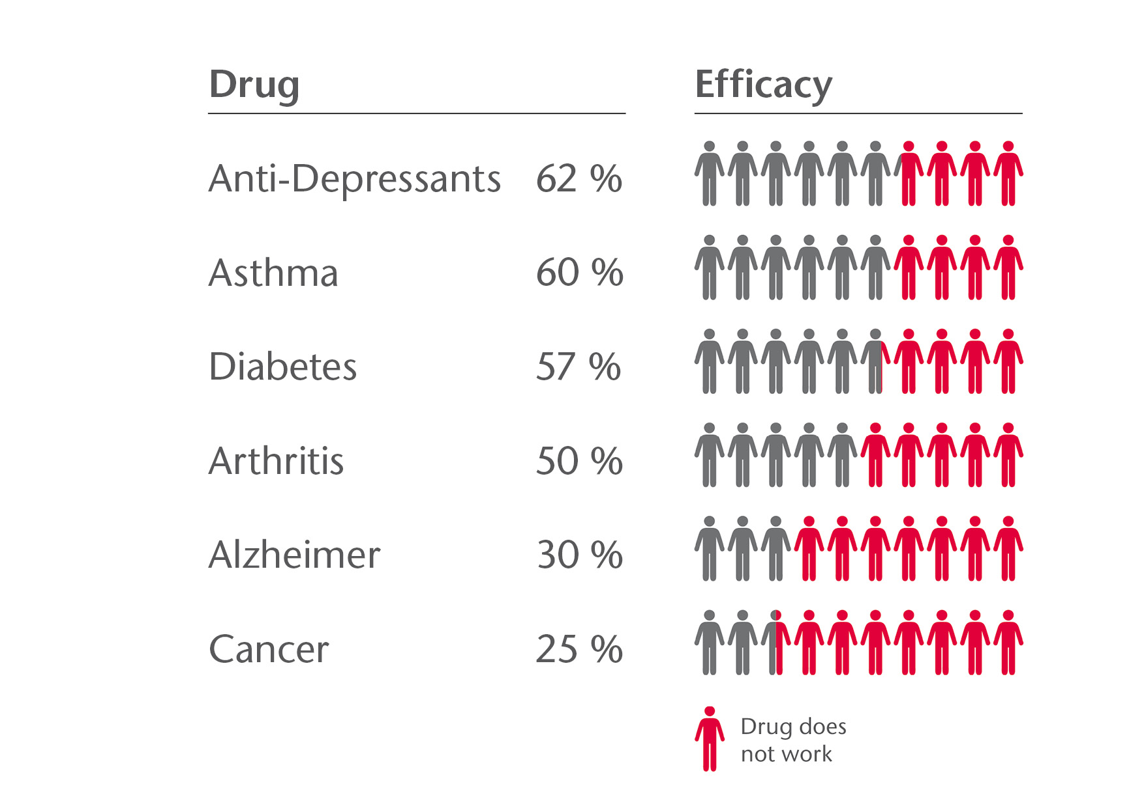

Slide 4

Medical examination
personalized healthcare
n=1 treatment.
shrink cohorts by analyzing more data.
patient-profiling

Slide 5
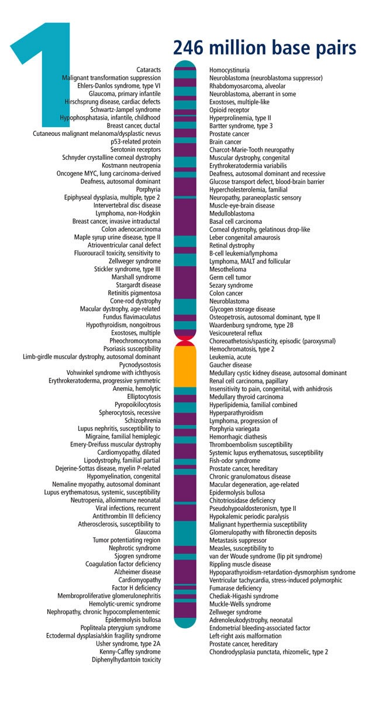
Unique Identifier

Slide 6

Notes:
Opmerkelijk: dit gaat over aantallen, over groei.

Slide 7

3.2 billion bases
ACTG
2 TB raw data
comparisons: enormous amounts of data
Notes:
Opmerkelijk: dit gaat over aantallen, over groei.

Slide 8


Slide 9
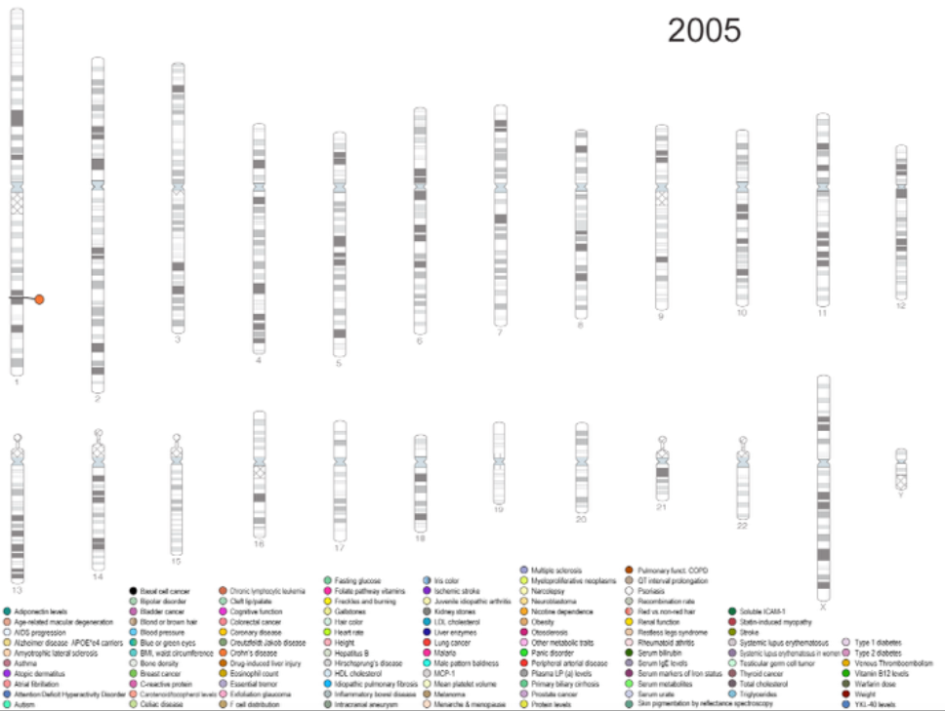

Slide 10
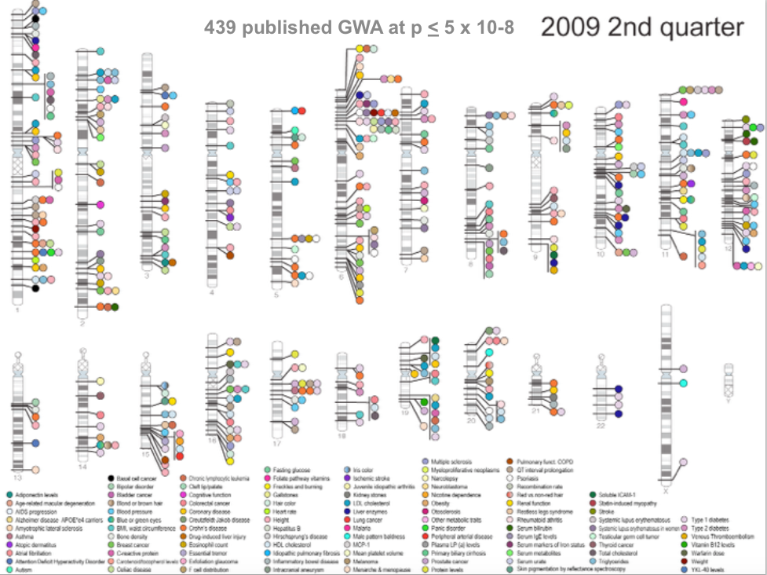

Slide 11
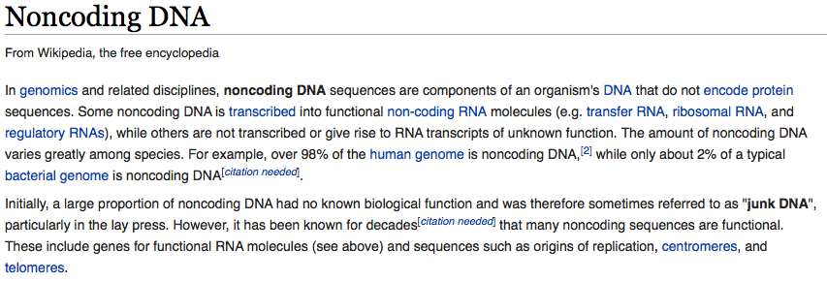


Slide 12


Slide 13


Slide 14
Open Data

Slide 15
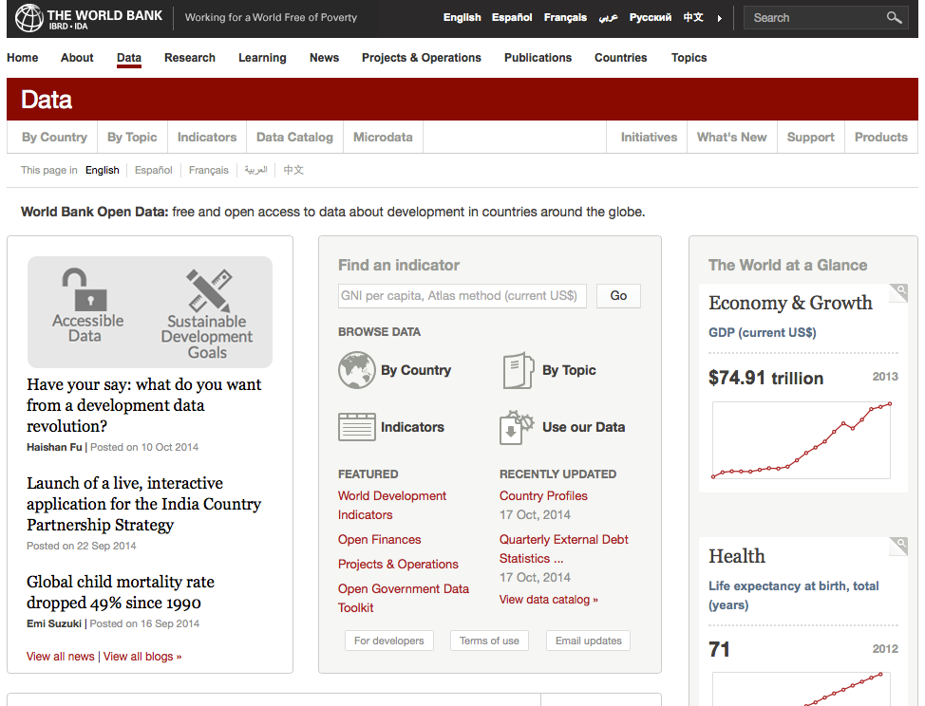
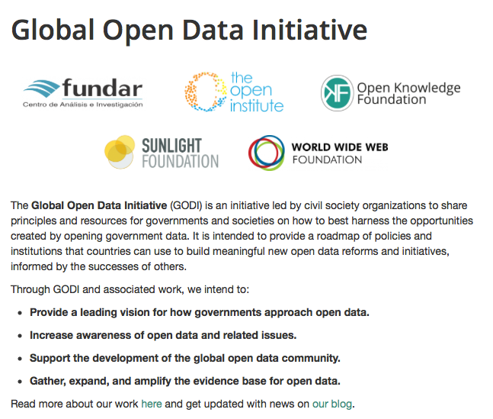
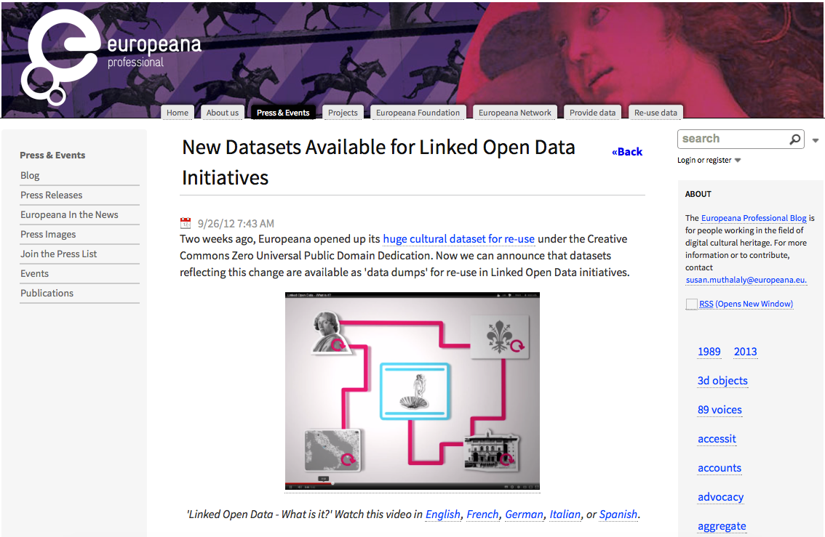
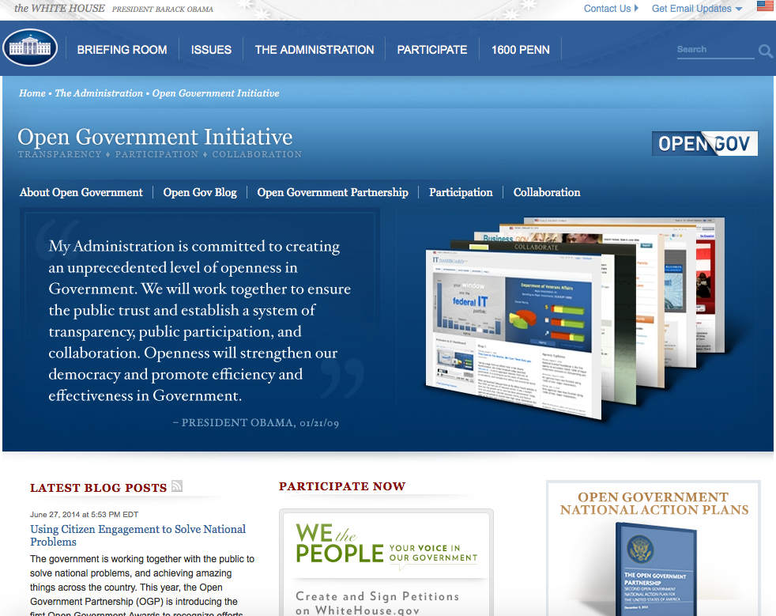

Slide 16
External
vs
Internal
DATA

Slide 17

We share more with our ‘followers’ than we do with our doctors…
#headache

Slide 18

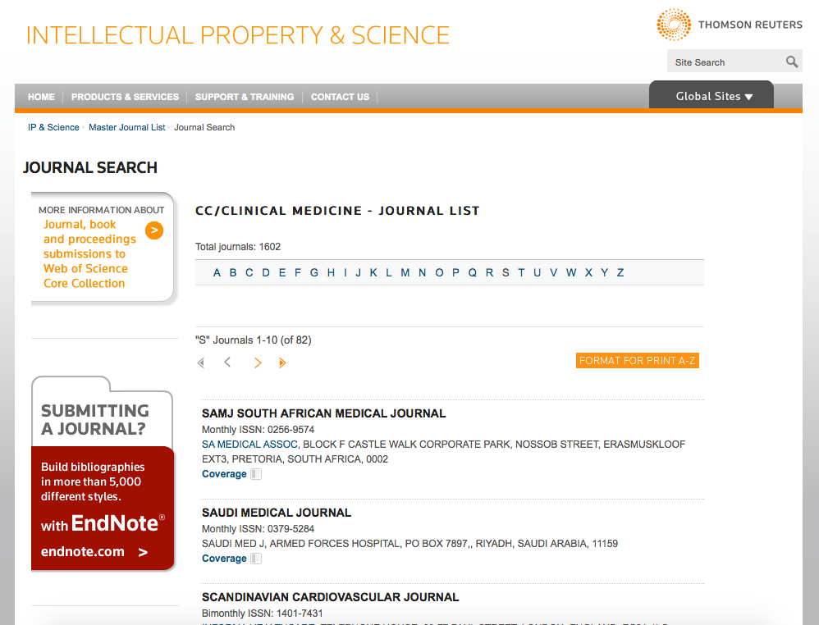
Notes:
Interessant: welke patiënten vertonen overeenkomstige patronen van ziektes, ziektebeelden en reacties op behandelingen ? (‘Patients like Mine’) —> Heel veel data.

Slide 19
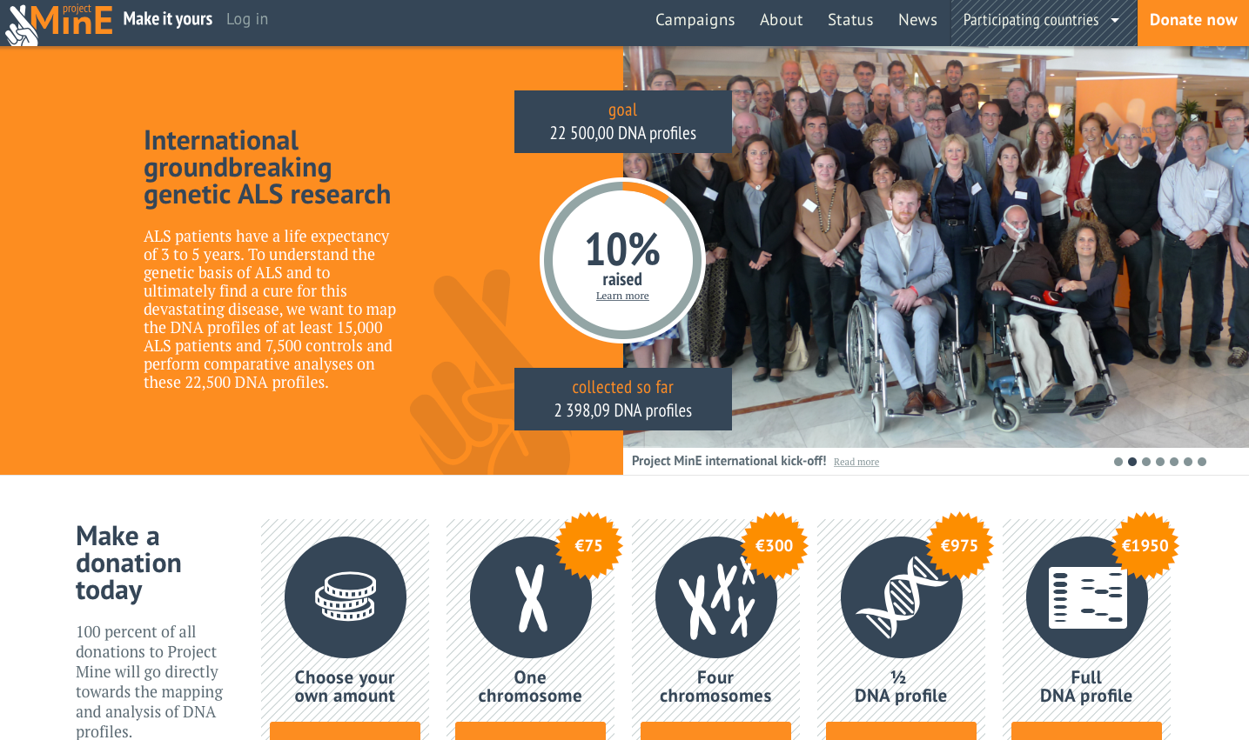

Slide 20
Oracle’s efforts
Big Data Appliance
Capturing of non-structured data
Webcrawling and capturing external data
Big Data SQL
Query non-structured data and structured data with a single (and well-known) language: SQL
Big Data Discovery
Early pattern detection

Slide 21
Oracle’s efforts
Oracle Exadata
Fastest database machine for Oracle databases
Extreme query response times
Extreme data reduction by means of compression
Oracle Database
Highly scalable
Industry standard
Support for extreme large datasets

Slide 22
VX Healthcare Analytics efforts
Huvariome
Web-environment for comparison of Whole Genome Sequences
Built on Oracle Exadata / Oracle Database
Server-side queries
Clients use a webbrowser, no client-tools needed
Scientific publication
Stubbs et al. Journal of Clinical Bioinformatics 2012, 2:19 http://www.jclinbioinformatics.com/content/2/1/19
Offered as on-site implementation or Cloud-solution
Allows for genomic patient profiling.

Slide 23
VX Healthcare Analytics efforts
Cloud offering for Oracle Translational Research Center
Combine clinical and genomic data
As well as lab results
Intervention data
Encounter data
BI front-end for cohort analyses
Custom visualizations based on open-source standards
Open platform: connect your own preferred analysis tools

Slide 24
Conclusion
Personalized Healthcare = Utopia ?
The more we know, the more we know that we don’t know much.
We need more (external) data to even come close to personalized diagnoses, let alone personal treatments.
patient-profiling is promising from a prediction point of view..

Slide 25


